Slide 1
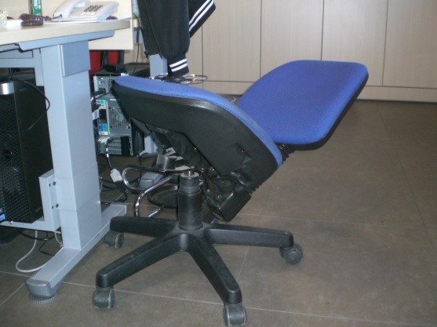
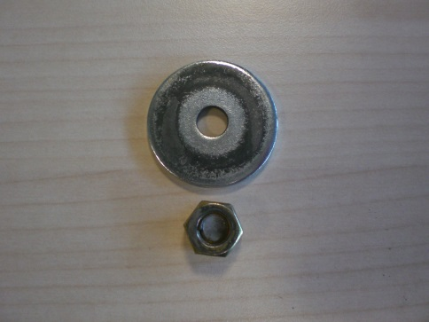
HS&E INCIDENT BULLETIN |  | 1st half year 2014
Location Country | Type of incident (example: Slip-Trip, Fall from Height, Vehicle , Laceration, Chemical Exposure)
Summary:
In technic office, contractor's employee fell down due to the chair rupture
Root Causes: | Actions Taken Thus Far: Next Steps
Inadequate controls of workstations in offices | Created dedicated mailbox for reporting anomalies, suggestions, improvement safety levels… Continuous monitoring of the adequacy workstations by responsible of area

